Slide 1
GNN for Predicting student’s Mastery Level

Slide 2
GNN for Predicting student’s Mastery Level
Objective : Predict a student's probability of answering a given question correctly, considering their previous responses, the learning objectives associated with the question, and the correctness of their previous answers.

Slide 3
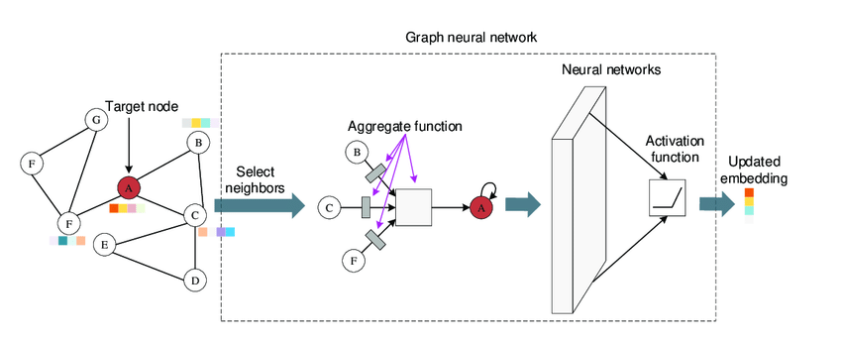
How GNN works
Source : https://www.researchgate.net/figure/A-typical-and-basic-architecture-and-processing-procedures-of-GNN-First-GNN-selects_fig2_352526255

Slide 4
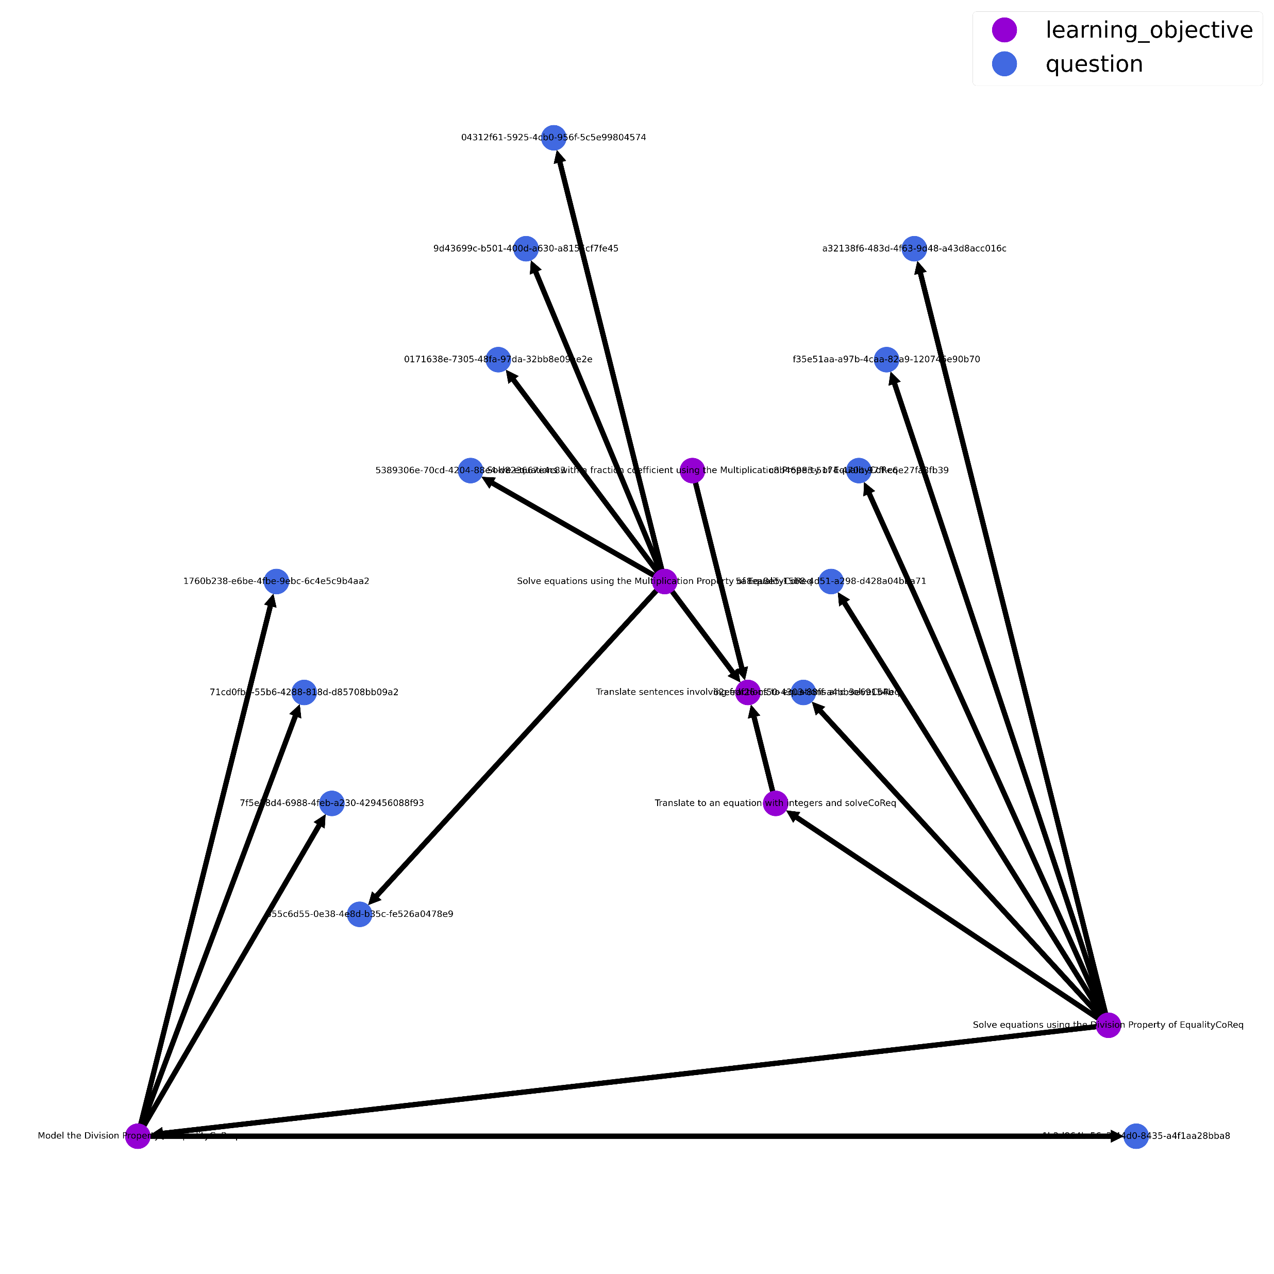
Knowledge Graph
 | Node | Features
 | Question | Question difficulty
 | Learning objective | Learning objective difficulty
Difficulty : Average number of correct answers
provided

Slide 5
GNN Classifier
………………
Q ₁
Q ₂
………………
Q _{t-2}
Q _{t-1}
Q _{t}
LO ₁
LO ₂
………………
LO _{t-2}
LO _{t-2}
LO _{t}
A ₁
A ₂
A _{t-1}
A _{t}
A ₂
A _{t-2}
Concatenate Question and learning objective embeddings with answers correctness of last three questions
GNN Layer
Convert node features embeddings
2
2
3
Q _{t-2} | LO _{t-2} | A _{t-3} | Q _{t-1} | LO _{t-1} | A _{t-2} | Q _{t} | LO _{t} | A _{t-1}
Linear Classifier
4
5
Y _{t}
1
1

Slide 6
GNN-LSTM Classifier
………………
Q ₁
Q ₂
………………
Q _{t-2}
Q _{t-1}
Q _{t}
LO ₁
LO ₂
………………
LO _{t-2}
LO _{t-2}
LO _{t}
A ₁
A ₂
A _{t-1}
A _{t}
A ₂
A _{t-2}
Reshape Question and learning objective embeddings with answers correctness of last three questions
GNN Layer
3
Convert node features embeddings
2
LSTM Classifier
Q _{t-2} | LO _{t-2} | A _{t-3}
Q _{t-1} | LO _{t-1} | A _{t-2}
Q _{t} | LO _{t} | A _{t-1}
4
1
5
Y _{t}

Slide 7
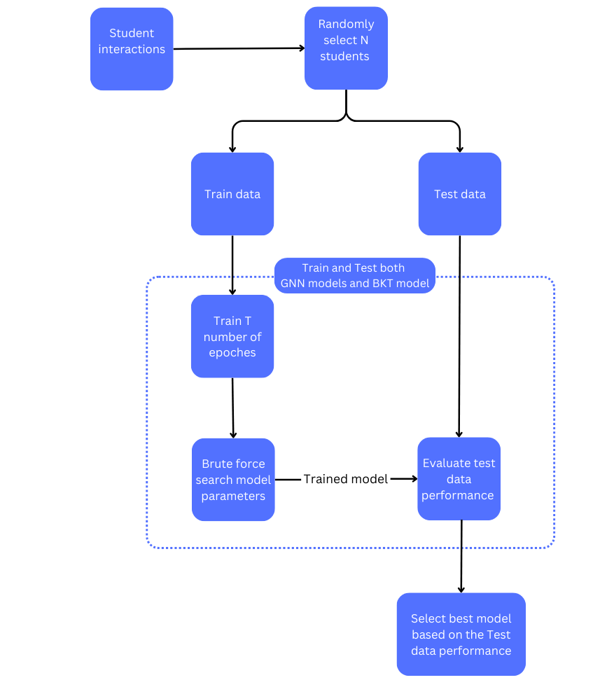
Evaluation
Randomly select n number of students
Split train and test data
Train on train data and brute force model optimization
Validate on test data
Compare models and benchmark against Bayesian Knowledge Tracing model.

Slide 8
Model Performance (test data)
5 students , 100 epochs per model , no batch training (each student interactions trained separately )
Model | AVERAGE of Accuracy | AVERAGE of ROC AUC
gnn | 60.92% | 60.69%
gnn_lstm | 55.61% | 58.62%
10 students , 25 epochs per model , batch trained
Model | AVERAGE of Accuracy | AVERAGE of ROC AUC
gnn | 63.87% | 68.87%
gnn_lstm | 66.36% | 69.34%

Slide 9
Further work
Add question similarity
Benchmark against Bayesian Knowledge Tracing model.

